Slide 1
Kafka
Notes:
Going over history, technical overview, and usecase
Key part of Umod integration architecture
We’re working with other teams at AO on Kafka
R&D project in Kafka
Kafka is a very important technology
Original implementation started in August last year and took just over a year for prod ready

Slide 2
Intro
Agenda
Brief history and overview of Apache Kafka
What is a queue?
What is PubSub?
What is a message broker?
AO Underwriting Usecase
Real-time event driven requirements
Issues with IBM MQ solution
Kafka as part of integration architecture
Demo
Policy Dashboard
Questions allowed
Notes:
Demystify Kafka by covering history and technology
Need to understand history to understand evolution to understand tech
Will explicitly answer all questions and tie them together
Will not be going deep technical
Had an actual hard usecase at AO
Comparison with IBM MQ
OS / Camel / Splunk / Kafka / Docker(?)
A year with Kafka

Slide 3
Background
Notes:
Set a baseline for everyone. There’s a few key things you need to understand to get why Kafka exists.

Slide 4
Background
Queue
Queue
Enqueue – add to queue
Dequeue – get from queue
FIFO - storage is sequential (array)
Constant access time
Burger
Pizza
Taco
Gushers
Constant access O(1)
4
3
2
1
4
3
2
1
3
2
4
First In First Out (FIFO)
1
Var access O(nlog(n))
Notes:
What is a queue
Queue is first in first out
Two functions: enqueue and dequeue
Order: pizza, taco, burgers, gushers
Array gives us constant time
Best case scenario on enq and deq
Unlike trees – optimized for searching
Important because pubsub messaging systems are implemented using queues
Same way a db is a tree/hashtable

Slide 5
Groundback
Publish Subscribe - problem
Why do we need pubsub?
Pizza
Maker
Orders
Taco
Maker
Pizza
Taco
Burger
Maker
Burger
Gushers
Gusher
Maker
Notes:
So what exactly pubsub? And why do we need it?
Make individual calls
We don’t do point to point communications

Slide 6
The ground behind you
Publish Subscribe - solution
Subscriber(s)
Publisher(s)
Pizza
Maker
Orders
Pubsub Systems
Pubsub channel
Taco
Maker
Pizza
Taco
Burger
Maker
Burger
Gushers
1 or many Publishers (producer)
1 or many Subscribers (consumer)
Guaranteed delivery*
Candy
Maker
Skittles
Broker
Notes:
Engineers introduce a pubsub system
System is a queue
Holds data
Responsible for getting data out
A queue alone doesn’t guarantee delivery – queue is just a datastructure
Need to have a broker for mediating communication

Slide 7
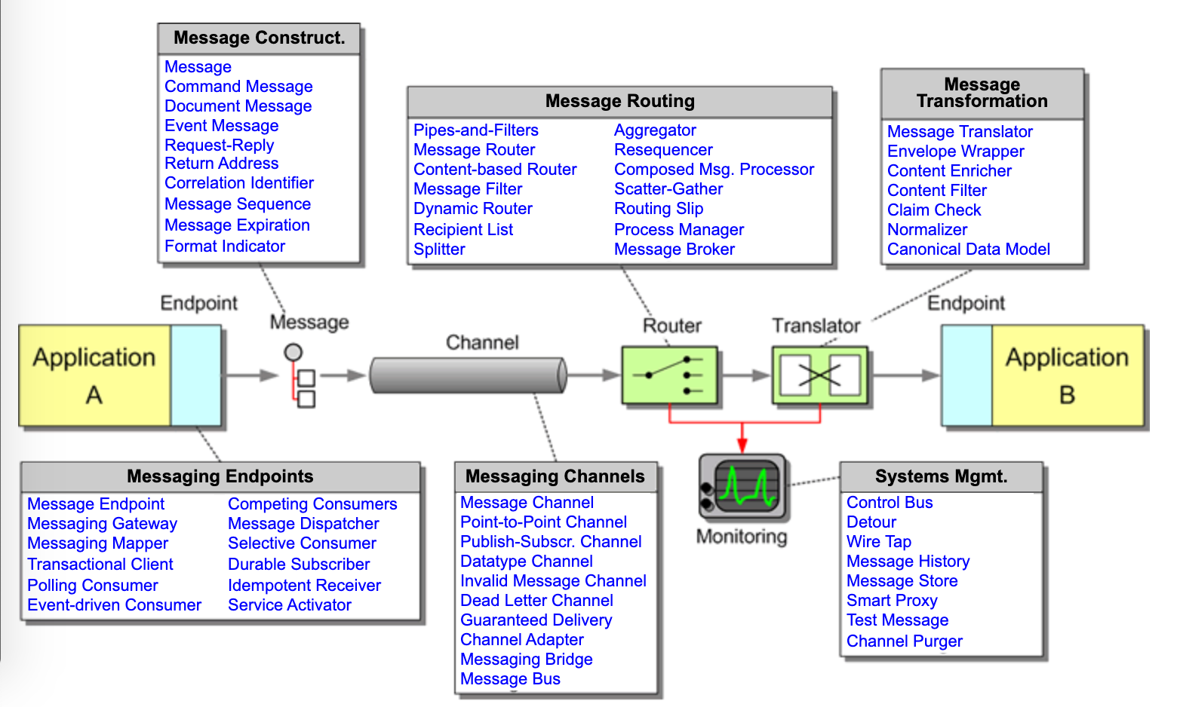
Behind ground
Message Broker

Slide 8
Gackbround
Publish Subscribe with Message Broker
Subscriber(s)
Pizza
Maker
Publisher(s)
Message broker
Orders
Pubsub Channel
Taco
Maker
Pubsub System
Pizza
Taco
Burger
Maker
Burger
Gushers
Candy
Maker
Skittles
Notes:
- Pubsub system is typically a coordination between these two patterns

Slide 9
Kafka

Slide 10
Kakfa
Brief History
Open-source stream-processing software
Developed by LinkedIn (2008?)
Usecases
[u]se cases for these platforms ranged from tracking site events like page views to gathering aggregated logs from other services. Other pipelines provided queueing functionality for our InMail messaging system, etc…^{(Koshy, 2016)}
Rather than maintaining and scaling each pipeline individually, we invested in the development of a single, distributed, pub-sub platform^{(Koshy, 2016)}
Apache Foundation Project Kafka
Graduated from incubator October 2012
Confluent – branched out from LinkedIn
Founders: Jun Rao, Jay Kreps, Neha Narkhede, etc…

Slide 11
Kafka
What is
Internet – lmgtfy(kafka)
Kafka is an open-source stream-processing software platform developed by LinkedIn. [It] aims to provide a unified, high-throughput, low-latency platform for handling real-time data feeds.^{(Wikipedia, 2019)}
Kafka is a highly scalable messaging system. [It is] a universal pipeline, built around the concept of a commit log, and was built with speed and scalability in mind.^{(Koshy, 2016)}
…scalable, fault-tolerant, publish-subscribe messaging system that enables you to build distributed applications…^{(Posta)}
It is a horizontally scalable messaging system…^{(Narkehe, 2015)}

Slide 12
Kafaka
What is
Kafka is an open-source stream-processing software platform developed by LinkedIn. [It] aims to provide a unified, high-throughput, low-latency platform for handling real-time data feeds.^{(Wikipedia, 2019)}
Kafka is a highly scalable messaging system. [It is] a universal pipeline, built around the concept of a commit log, and was built with speed and scalability in mind.^{(Koshy, 2016)}
…scalable, fault-tolerant, publish-subscribe messaging system that enables you to build distributed applications…^{(Posta)}
It is a horizontally scalable messaging system…^{(Narkehe, 2015)}
Data
Stream-processing
Real-time events
Publish-subscribe
Messaging system
Performance
High-throughput
Low-latency
Distributed/scalable
Reliability
Fault-tolerant
(pic: Waehner, 2018)
Notes:
- LinkedIn built this monster. But why?

Slide 13
Kafka
Clicks
click
click
click
LinkedIn

Slide 14
Kafka
Clickss
Analytics
click
click
click
Reporting
LinkedIn
NSA…
Etc.
Real-time
Stream-processing

Slide 15
Kafka
Clicksss
Analytics
click
click
click
Reporting
Pubsub System
Click Channel
LinkedIn
NSA…
Etc.
What about scale?

Slide 16
Kafka
What is
Internet – lmgtfy(kafka)
Kafka is an open-source stream-processing software platform developed by LinkedIn. [It] aims to provide a unified, high-throughput, low-latency platform for handling real-time data feeds.^{(Wikipedia, 2019)}
Kafka is a highly scalable messaging system. [It is] a universal pipeline, built around the concept of a commit log, and was built with speed and scalability in mind.^{(Koshy, 2016)}
…scalable, fault-tolerant, publish-subscribe messaging system that enables you to build distributed applications…^{(Posta)}
It is a horizontally scalable messaging system…^{(Narkehe, 2015)}

Slide 17
Kafka
Clicksss
Analytics
click
click
click
Reporting
Pubsub System
Pubsub Channel
LinkedIn
NSA…
Etc.

Slide 18
Kafka
Key
Clicksss
10,000 clicks/sec
Analytics
Reporting
UI
API
Pubsub System
NSA…
Etc.

Slide 19
Kafka
Key
Clicksss
10,000 clicks/sec
Analytics
UI
API
Reporting
LB
UI
API
Pubsub System
UI
API
NSA…
Etc.

Slide 20
Kafka
canadians…
Key
UI
API
Clicksss
10,000 clicks/sec
US-EAST
UI
API
LB
UI
API
LB
UI
API
Analytics
UI
API
UI
API
US-CENTRAL
Reporting
UI
API
Pubsub System
LB
UI
API
NSA…
UI
API
ASIA
Etc.
UI
API
LB
UI
API
Moon
UI
API
UI
API
~150,000 clicks per second to handle
LB
UI
API
UI
API
Realistically goes into trillions…

Slide 21
sidenote…
Performance at UMod

Slide 22
Kafka
Clicksss
UI
API
Pubsub System
(Kafka)
Consumers
LB
UI
API
UI
API

Slide 23
Kafka
Clicksss
UI
API
Kafka
Click Channel
Broker
Consumers
LB
UI
API
Zookeeper
UI
API
Zookeeper
Broker status
Leadership elections

Slide 24
Kafka
Clicksss
Kafka
Click Channel p1
Broker1
UI
API
Click Channel p2
Broker2
Consumers
LB
UI
API
Zookeeper
UI
API
Click Channel p3
Broker3

Slide 25
Kafka
Clicksss
Click Channel p1
Kafka
Broker1
L
s
Leader serves all requests from publishers and subscribers
Slave
Replicate leader data
Trigger leader election
UI
API
Click Channel p1
Broker2
UI
API
Click Channel p2
L
LB
s
Zookeeper
Consumers
UI
API
Click Channel p1
Broker3
s
Click Channel p3

Slide 26
Kafka
Clicksss
Click Channel p1
Kafka
Broker1
Click Channel p2
L
Click Channel p3
s
s
UI
API
Click Channel p1
Broker2
LB
UI
API
Click Channel p2
s
Click Channel p3
L
Zookeeper
Consumers
UI
API
s
Click Channel p1
Broker3
Click Channel p2
s
Click Channel p3
Four Guarantees of Kafka
Kafka provides order guarantee of messages in a partition
Produced messages are considered “committed”
Messages that are committed are permanent (durable)
Consumers can only read messages that are committed
s
L

Slide 27
Kafaka
What is
Kafka is an open-source stream-processing software platform developed by LinkedIn. [It] aims to provide a unified, high-throughput, low-latency platform for handling real-time data feeds.^{(Wikipedia, 2019)}
Kafka is a highly scalable messaging system. [It is] a universal pipeline, built around the concept of a commit log, and was built with speed and scalability in mind.^{(Koshy, 2016)}
…scalable, fault-tolerant, publish-subscribe messaging system that enables you to build distributed applications…^{(Posta)}
It is a horizontally scalable messaging system…^{(Narkehe, 2015)}
Data
Stream-processing
Real-time
Publish-subscribe
Performance
High-throughput
Low-latency
Distributed/scalable
Reliability
Fault-tolerant

Slide 28
Case Study – Underwriting Modernization

Slide 29
Case Study – Underwriting Modernization
Underwriting Modernization
Building a Policy Admin System
Agent or Underwriter logins in and creates Policies
Real-time event driven platform for Agents
Real-time features
Policy dashboard
Dec printing
Billing accounts
Reconciliation
Policy referral/approval

Slide 30
Case Study - Underwriting Modernization
Pubsub
Policy Dashboard
Pubsub System
Billing Accounts
Transactions
Policy Administration
Reconciliation
etc.

Slide 31
Case Study - Underwriting Modernization
Pubsub
Policy Dashboard
Tx Channel
Billing Accounts
Transactions
IBM MQ
Policy Administration
Reconciliation
etc.

Slide 32
Case Study - Underwriting Modernization
Pubsub
“Durable” Subscriber
IBM MQ
Policy Dashboard
Tx Channel
Billing Accounts
Transactions
Policy Administration
Reconciliation
etc.
System is unreliable
Max limits on queues

Slide 33
Case Study - Underwriting Modernization
Original Architecture

Slide 34
Case Study - Underwriting Modernization
Pubsub
Persisted data
Policy Dashboard
Tx Channel Partition
Billing Accounts
Transactions
Policy Administration
Reconciliation
etc.

Slide 35
Case Study - Underwriting Modernization
Tx Channel Partition
Pubsub
Persisted data
Policy Dashboard
7
6
5
4
3
2
1
Billing Accounts
Transactions
Policy Administration
Reconciliation
etc.

Slide 36
Case Study - Underwriting Modernization
Tx Channel
Pubsub
Persisted data
Policy Dashboard
7
6
5
4
3
2
1
Billing Accounts
Transactions
Policy Administration
Reconciliation
etc.
Reliable Pubsub Implementation

Slide 37
Case Study - Underwriting Modernization
Beyond Pubsub
Pubsub system (Nov 2018)
PAS Transactions
PAS Quotes
PAS Batches and Batch Framework (May 2019)
Kafka Streams API (May 2019)
Real-time Tx Reconciliation
Kafka Connect API (July 2019)
SQL CDC Source
SQL Sink
AO Kafka API/UI
Klack UI
Further
Harvesting IP – Kafka API, UI, Index, Graphql endpoint
R&D - Microservices with Kafka?

Slide 38
Demo – Policy Admin System

Slide 39
Final thoughts

Slide 40
Appendix

Slide 41
Appendix
References
Koshy Joel - https://insidebigdata.com/2016/04/28/a-brief-history-of-kafka-linkedins-messaging-platform/, Apr 28, 2016
Narkhede, Neha - https://www.confluent.io/blog/apache-kafka-hits-1-1-trillion-messages-per-day-joins-the-4-comma-club/, Sept 1, 2015
Posta, Christian - https://techbeacon.com/app-dev-testing/what-apache-kafka-why-it-so-popular-should-you-use-it, date unknown
Waehner, Kai - https://www.confluent.io/blog/using-apache-kafka-drive-cutting-edge-machine-learning, Nov 19, 2018

